Slide 1


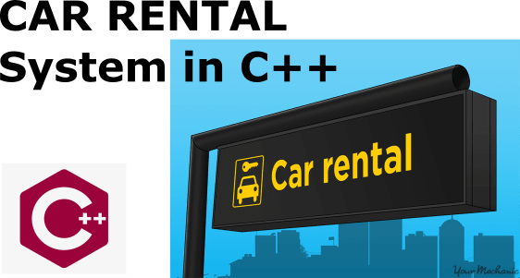
DSA0182 – OOPS – Slot A
Car rental system using CPP
Guided By,
Dr. Manikandan .T
(Course Faculty)
OOPS
SSE, SIMATS
Project by,
Rohinth.R(192225115)
Sathya Narayanan .E(192224252)
AI&DS, SSE, SIMATS

Slide 2
TABLE OF CONTENTS
Introduction
Requirement & Analysis
Scope
Design
Code
Output
Conclusion

Slide 3
INTRODUCTION
The Car Rental System in C++ ensures secure user authentication for customers and administrators.
It features a robust vehicle management module, allowing easy addition, updating, and removal of vehicles along with associated details.
Customers can conveniently browse available vehicles, make reservations, and benefit from a real-time availability check.
Rental transactions are streamlined, with the system generating agreements, processing payments, and calculating charges based on rental duration and rates.
The admin dashboard provides centralized control, allowing administrators to efficiently manage the entire system, access valuable statistics, and monitor customer and vehicle information effectively.

Slide 4
HARDWARE & SOFTWARE REQUIREMENTS
HARDWARE REQUIREMENTS:
Processor: 11th Gen Intel(R) Core(TM) i5-11400F @ 2.60GHz
RAM: 8.0 GB or 16.0 GB
Storage Space: 512GB
SOFTWARE REQUIREMENTS:
Editor: Dev C++
Operating System: Windows 10 or Windows 11 x64 Bit

Slide 5
SCOPE
The scope of the Student Management System are:
Scalability:
Designing the system for scalability to accommodate the growth of the car rental business by expanding database capabilities, user capacity, and transaction processing.
Integration with External Systems:
Extending the system to integrate with external services like online payment gateways, GPS tracking, and CRM tools for enhanced functionality.
Advanced User Interfaces:
Future development can focus on creating more user-friendly interfaces, including the possibility of a web-based or mobile application for seamless customer access.
Analytics and Reporting Enhancements:
Expanding the system to provide sophisticated analytics tools and reporting capabilities for data-driven decision-making and deeper insights.
Automation and AI Integration:
Implementing automation features, such as automatic billing, reminders, and incorporating artificial intelligence for predictive analysis to optimize operational efficiency.

Slide 6
DESIGN
Architecture:
Modular approach (e.g., MVC).
Divided into modules like User, Car, payment.
Classes:
Mark , model , color , max_speed
Define attributes and methods for each class.
UI Design:
Intuitive GUI using relevant libraries.
Wireframes for key functionalities.
Data Storage:
Database system selection (e.g., MySQL).
Design tables/entities and relationships.
Security:
Secure authentication with hashing.
Role-based access control

Slide 7
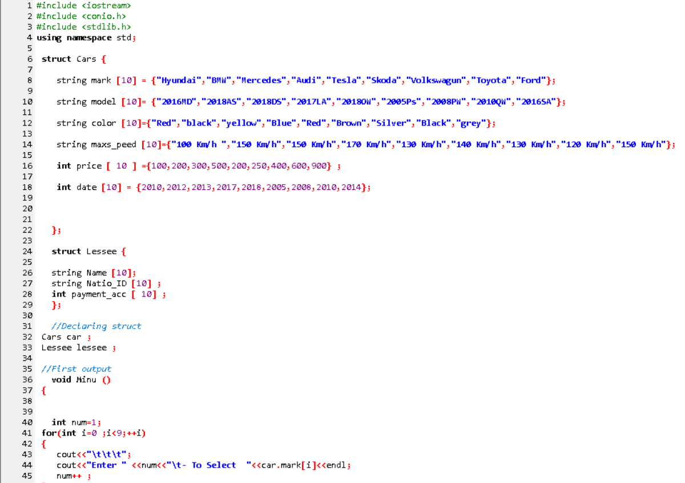
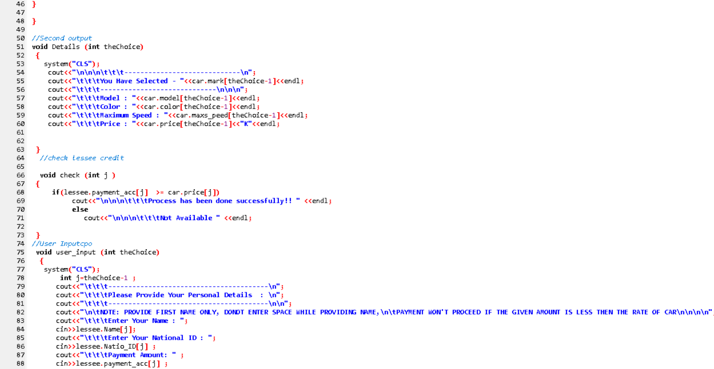
CODING

Slide 8
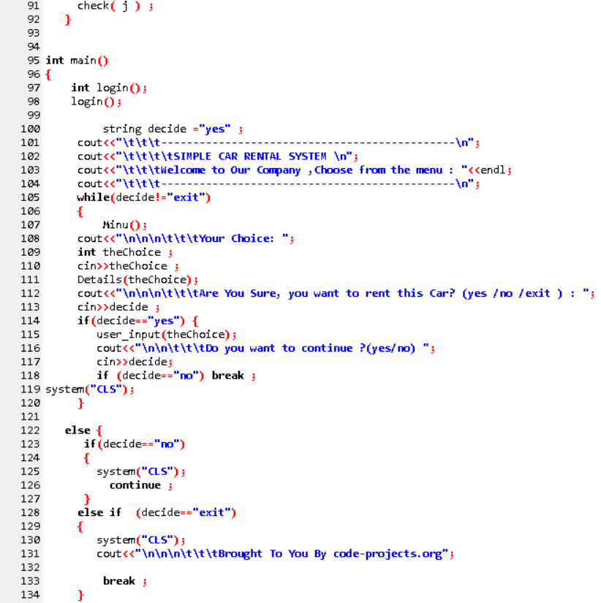
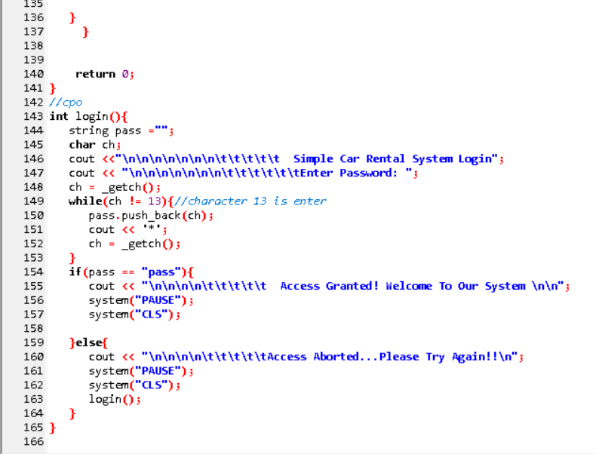

Slide 9
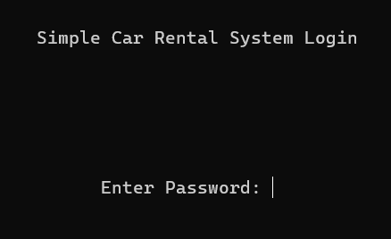
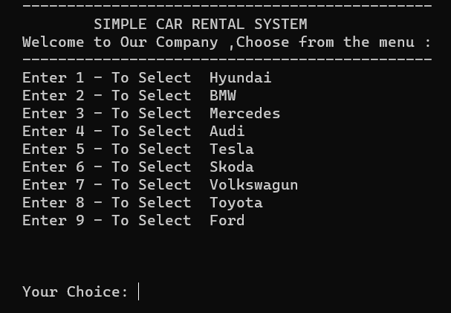
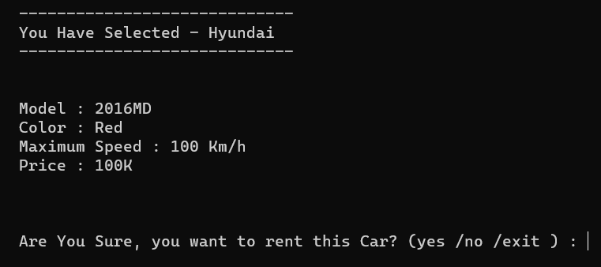
FINAL OUTPUT

Slide 10
CONCLUSION
In summary, the C++ code illustrates a basic car rental system using struct-like classes. The system lacks a modular architecture and could benefit from a transition to true classes for improved encapsulation. The console-based UI limits user experience, suggesting a need for a graphical interface. Additionally, static data storage could be enhanced with a database system for scalability. Security measures, including hashed passwords and role-based access, should be implemented to address vulnerabilities. These refinements would contribute to a more robust, user-friendly, and secure car rental system.

Slide 11


